Slide 1
Multi-Temporal Diffusion Model for Cloud Removal
in Satellite Imagery
Team Members:
Sihan Yao & Yuxuan Huang
COMPSCI-372 Final Project

Slide 2
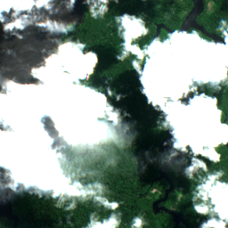
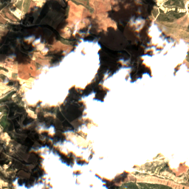
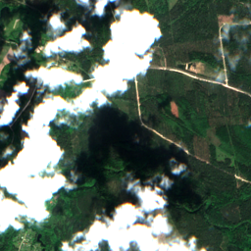
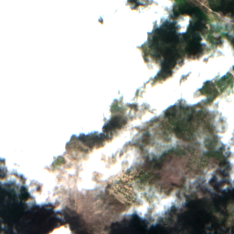
Overview
Up to 67% of Earth’s land surface is cloud-covered at any moment
They significantly hinder the visibility of terrestrial targets in satellite observations.
-> Cloud removal from satellite images has its natural importance.

Slide 3
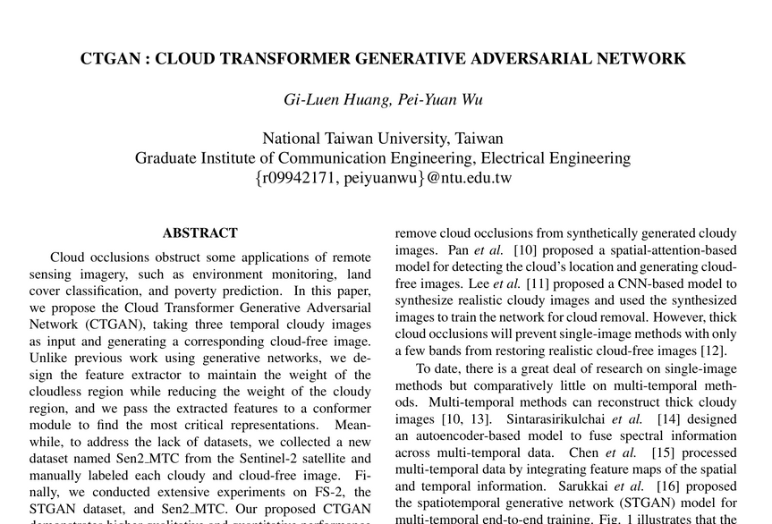
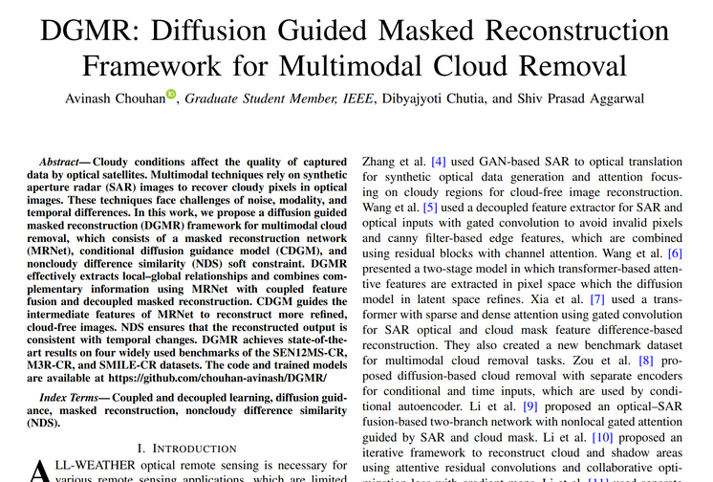
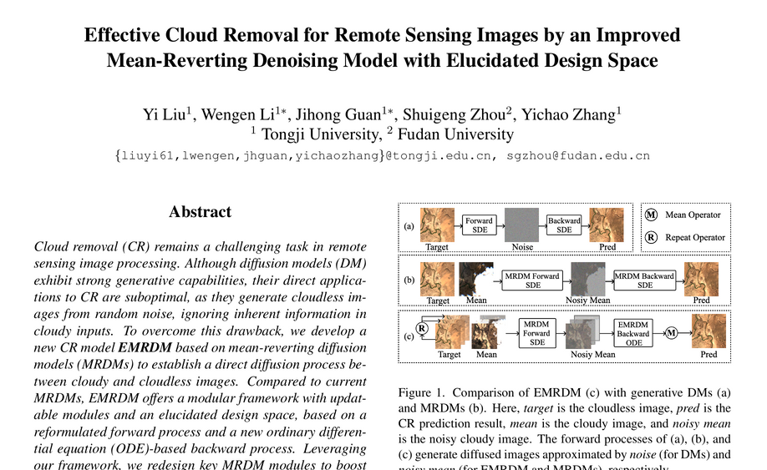
Current methods
Supervised Image-to-Image Models
GAN-based
CNN/UNet Regression
Mask-Guided Cloud Removal
Mask-based UNet
Attention-based
Multi-Temporal Deep Learning
GAN-based
Temporal HDiT
Encoder-Condition-Diffusion Model ---- Ours

Slide 4
Our method:
Encoder-Conditioned Diffusion
= Multi-Temporal Encoder + Diffusion Denoising
The idea:
Data: 3 cloudy images VS 1 clean image of 4 channels (RGB + NIR) of the same place
The model tires to learn what’s behind the clouds through Encoder
Learn patterns of land, water, and landscapes from examples
Remove clouds step-by-step via Diffusion
Output a clean, cloud-free image
*NIR: Near-Infrared, represented in gray-scale

Slide 5
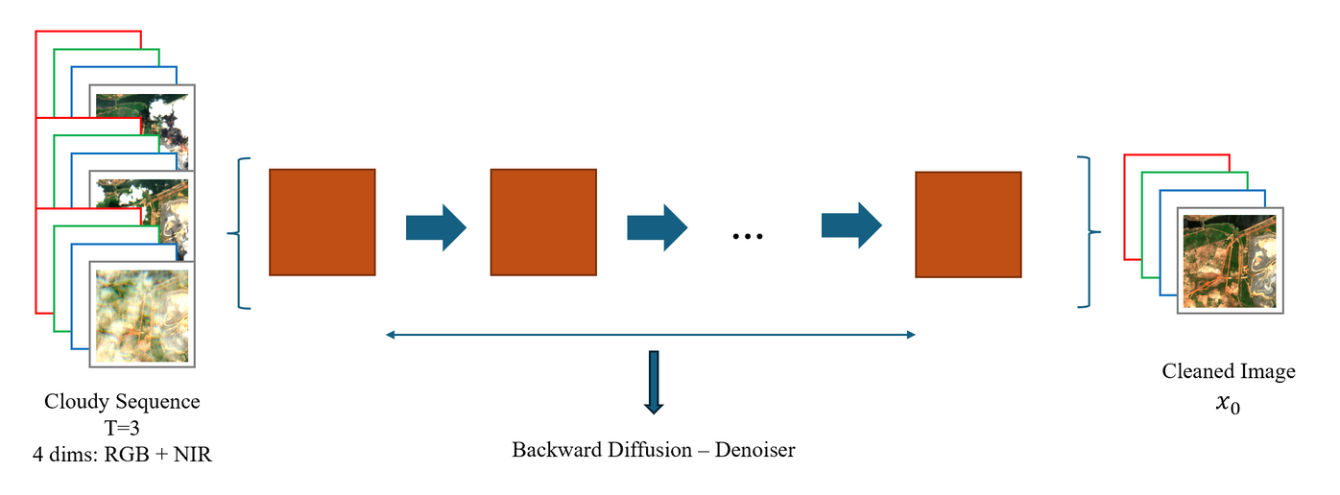
Our method:
One step further, the model should:
learn from all 3 cloudy frames
learn their common features
start from a noisy version of 1 cloudy frame
remove a little noise at each step
produce a clean image where noise are removed

Slide 6
Why it would work?
Clouds move → different images reveal different parts, collectively infer the real clean image
Taking advantage of time gives the model more clues
The model learns what Earth features “should” look like
Removing clouds progressively prevents mistakes and weird artifacts
Benefits:
Bypass the need of cloud masks → losser data requirement
Internally learns a solid representation of clouds in its latent space
A relatively small model size (50M for our bigger model)

Slide 7
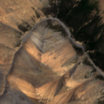
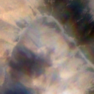
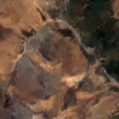
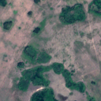
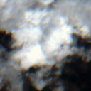
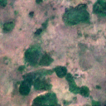
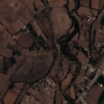
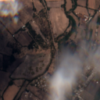
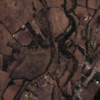
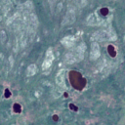
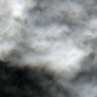
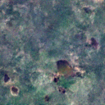
Example results:
From test_set
From val_set
Clean
Cloudy
(input)
Removed
Clean
Cloudy
(input)
Removed

Slide 8
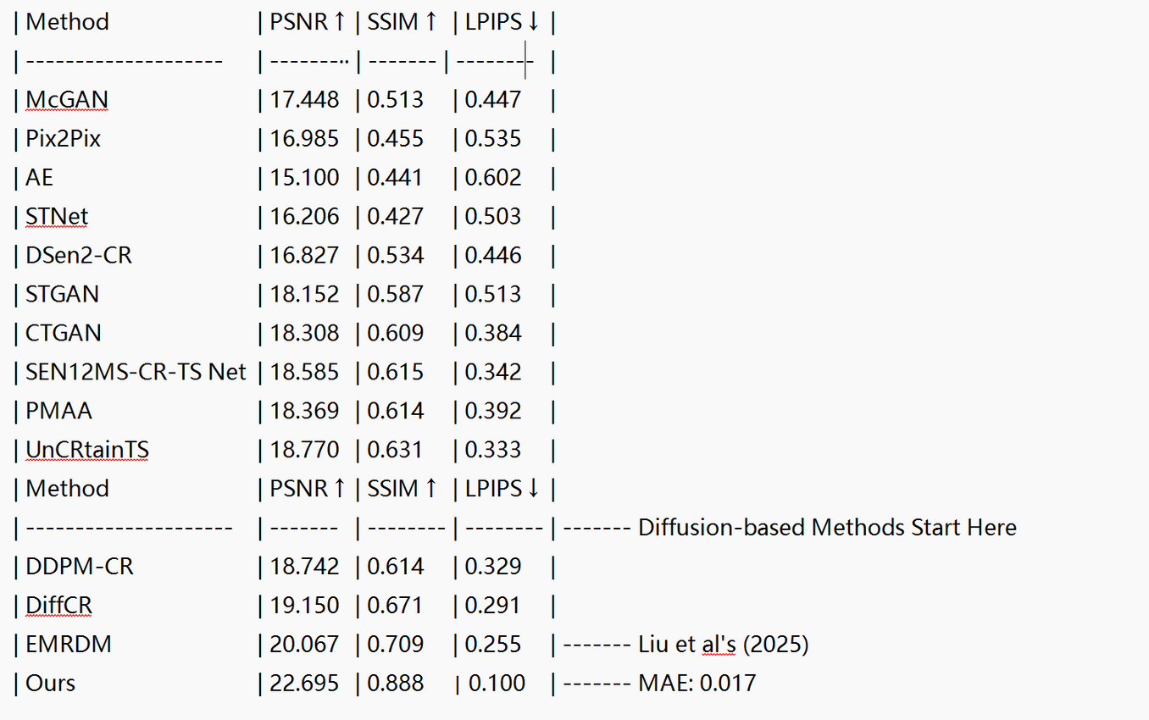
Quantitative evaluation:
Quantitative evaluation table from Liu et al. (2025)
Our method outperforms ALL existing models on the Sen2-MTC dataset

Slide 9
Implication:
More accurate environmental analysis
Helps ML models trained on satellite imagery
Makes satellite data more reliable overall
Downstream adaptations
Tasks on satellite imagery & remote censoring
Current: manually filter out cloudy data
With robust cloud removal methods:
Increase data availability
Better monitoring on diverse missions

Slide 10
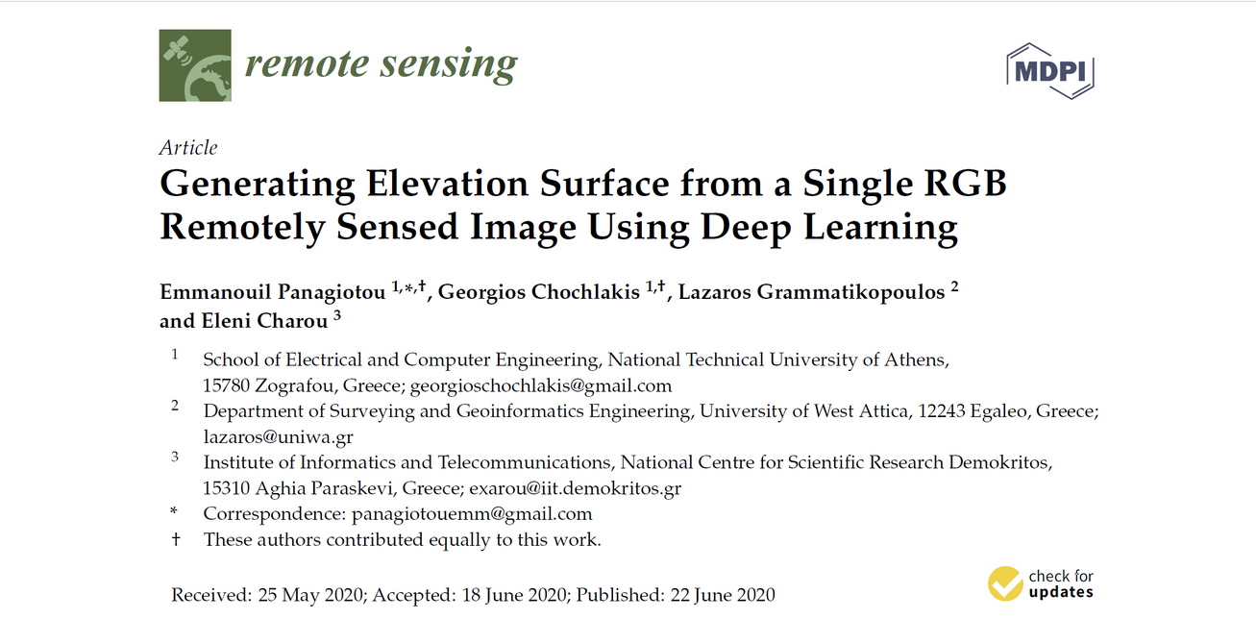
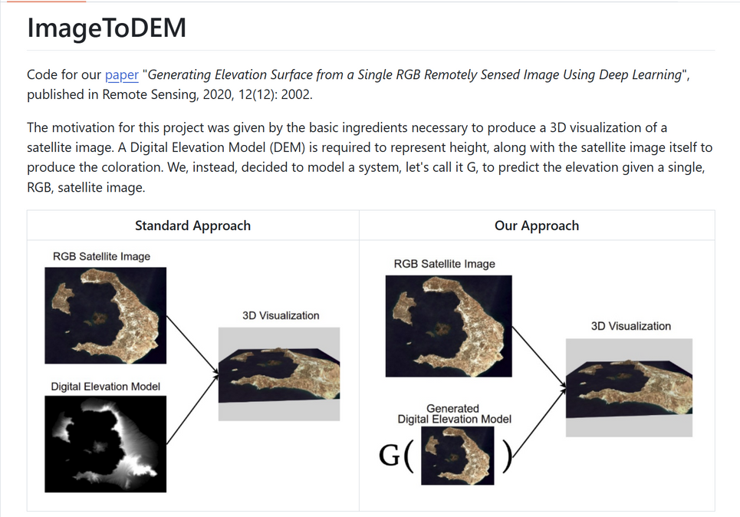
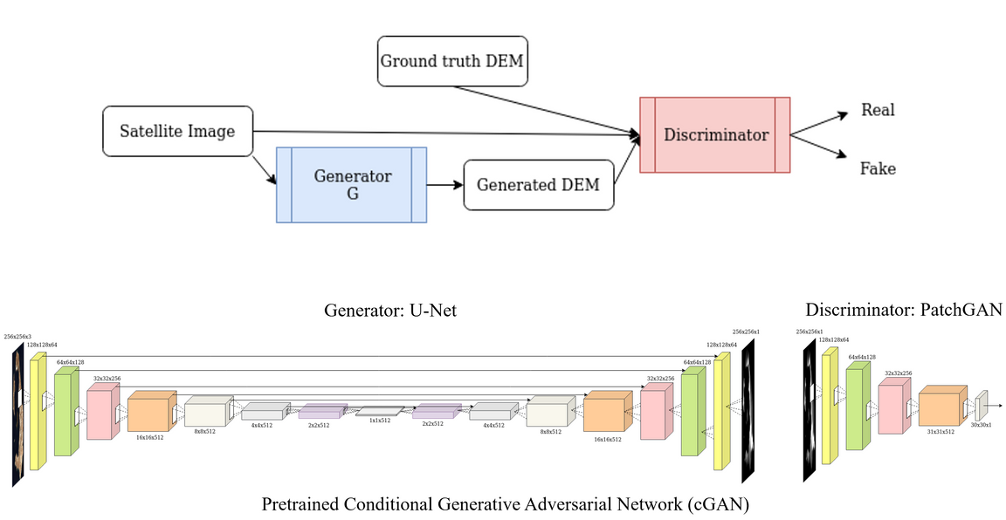
Downstream task:
Downstream Use Case: Elevation Mapping
Many tasks (flood prediction, land monitoring, planning) rely on terrain information
We used a published model that generates a height map （DEM） from a single RGB satellite image
Cloudy Images confuse the model → inaccurate elevation
Panagiotou et al. (2020)

Slide 11
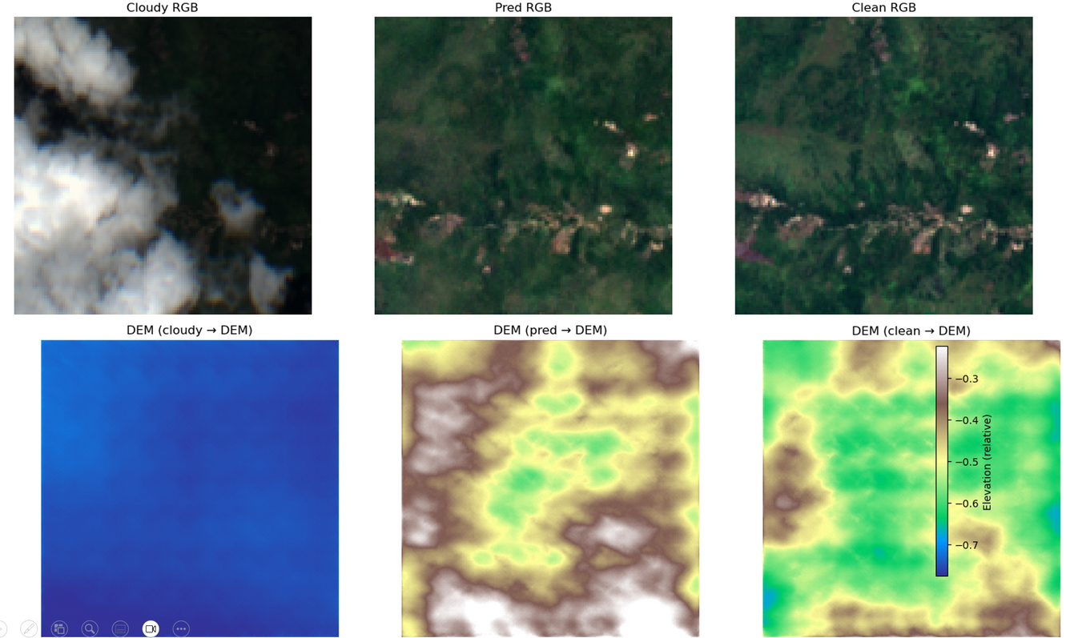
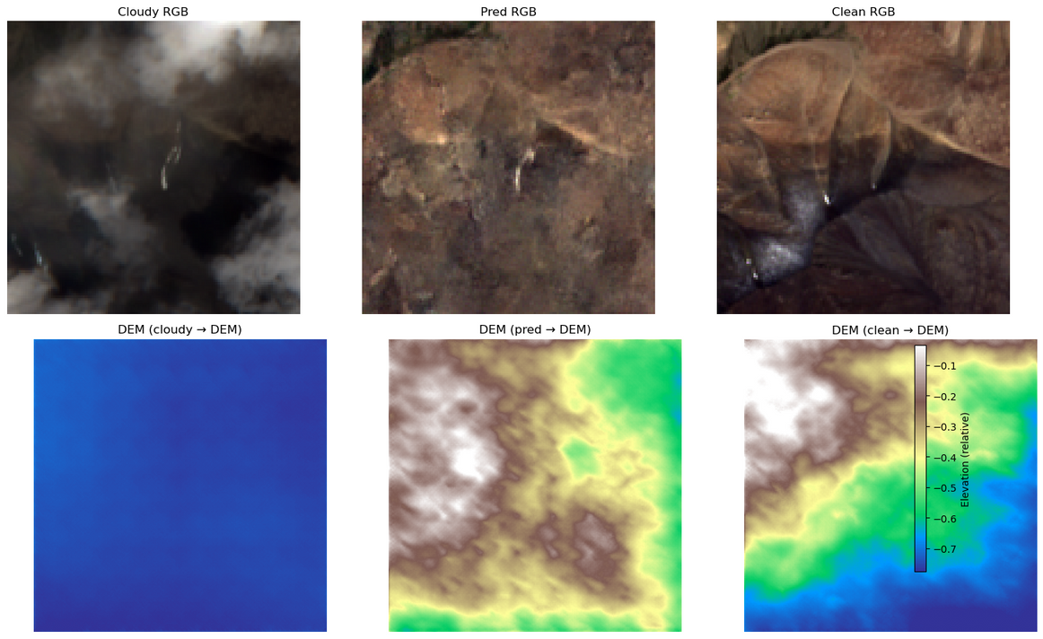
Example results:
From test_set
From val_set
Cloudy
Removed
Clean
（Baseline）
Cloudy
Removed
Clean
(Baseline)

Slide 12
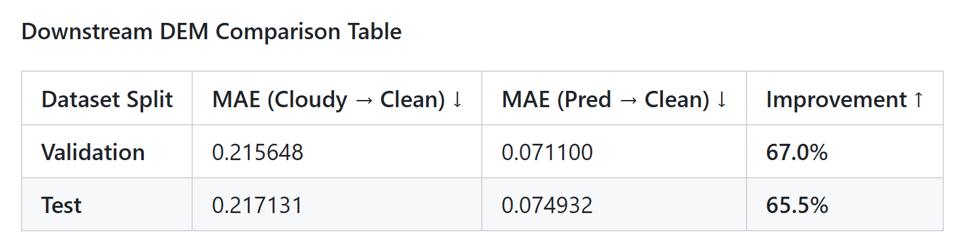
Quantitative evaluation:
These results suggest that cloud removal is not merely cosmetic
Evidenced by a 65–67% reduction in DEM reconstruction error when using our predicted images.

Slide 13
References:
Huang, G.-L., & Wu, P.-Y. (2022). CTGAN: Cloud Transformer Generative Adversarial Network. 2022 IEEE International Conference on Image Processing (ICIP), 511–515. https://doi.org/10.1109/ICIP46576.2022.9897229
Liu, Y., Li, W., Guan, J., Zhou, S., & Zhang, Y. (2025). Effective Cloud Removal for Remote Sensing Images by an Improved Mean-Reverting Denoising Model with Elucidated Design Space.
Panagiotou, E., Chochlakis, G., Grammatikopoulos, L., & Charou, E. (2020). Generating elevation surface from a single RGB remotely sensed image using deep learning. Remote Sensing, 12(12), 2002. https://doi.org/10.3390/rs12122002

Slide 14
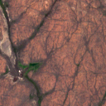
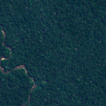
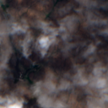
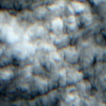
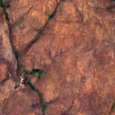
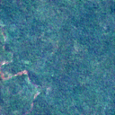
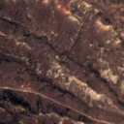
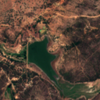
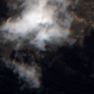
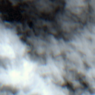
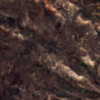
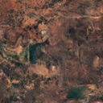
Thank you

